Slide 1
HALL BOOKING MINI PROJECT
BY
KOMAL SWAMI
AND SHIVANI SINGH

Slide 2
ABOUT THE PROJECT
Technical Details :
Programming Language : Java is used to develop the features in the backend.
User Interface : Java Swing and AWT libraries are used to develop the UI.
Database : MySQL is used as a Database, JDBC as a connector to database from Java and SQL as the query language to send and retrieve data.
Storage : Java Arraylists APIs are also used to store the data about the user and bookings, if not opted for DB.

Slide 3
FEATURES
THE PROJECT PROVIDES BASIC FEATURES AND FUNCTIONALITIES ABOUT BOOKING HALL .
THESE FEATURES ARE DESCRIBED BELOW---
BOOKING HALL
THE USER CAN EASILY SIGN IN BY ENTERING NAME, PHONE NUMBER AND PASSWORD BY INTERACTING WITH JAVA SWING UI AND BOOK HALL PROVIDING RESPECTIVE DATE FOR BOOKING.
IF THE DATE IS AVAILABLE THE BOOKING WOULD BE CONFIRMED .
CHECK BOOKING
THE USER CAN ALSO CHECK THE BOOKING BY CLICKING ON THE BUTTON PROVIDED TO THE USER.
THE SYSTEM WILL SHOW THE BOOKING IF AVAILABLE.
Notes:
THIS IS THE FIRST SLIDE

Slide 4
FEATURES
UPDATE BOOKING
THE SYSTEM PROVIDES FACILITY OF UPDATING THE BOOKING TO THE USER.
THAT CAN BE ACCOMPLISHED JUST BY GIVING THE PREVIOUS AND NEW DATE HE WANT TO UPDATE INTO.
CANCEL BOOKING
BOOKING CAN ALSO BE CANCELLED BY THE USER JUST BY GIVING THE DATE HE WANT TO CANCEL.
THE USER IS ALSO PROVIDED WITH THE OPTION OF CANCELLING ALL HIS BOOKINGS AT A TIME.
Notes:
THIS IS THE SECOND SLIDE

Slide 5
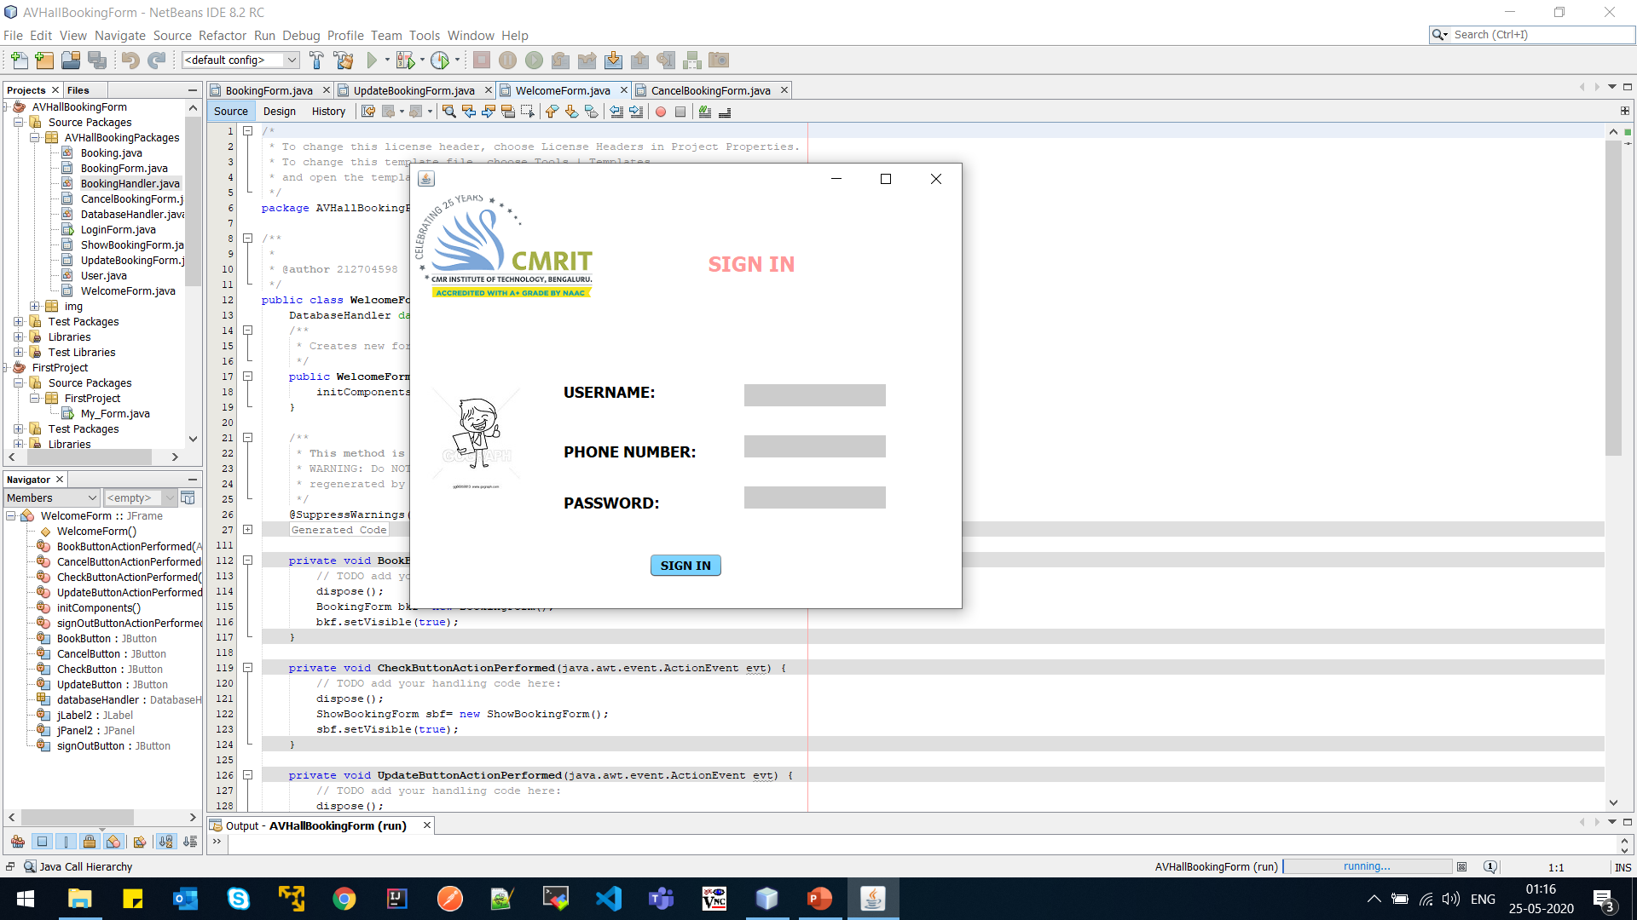
SIGN IN SCREEN
SIGN IN SCREEN WILL OPEN UP AT THE BIGINNING OF THE PROJECT
USER WILL BE ASKED TO ENTER NAME, PHONE NUMBER AND PASSWORD TO CREATE USER ID
USER CAN SIGN IN THEN AND WILL BE TAKEN TO THE MENU PAGE

Slide 6
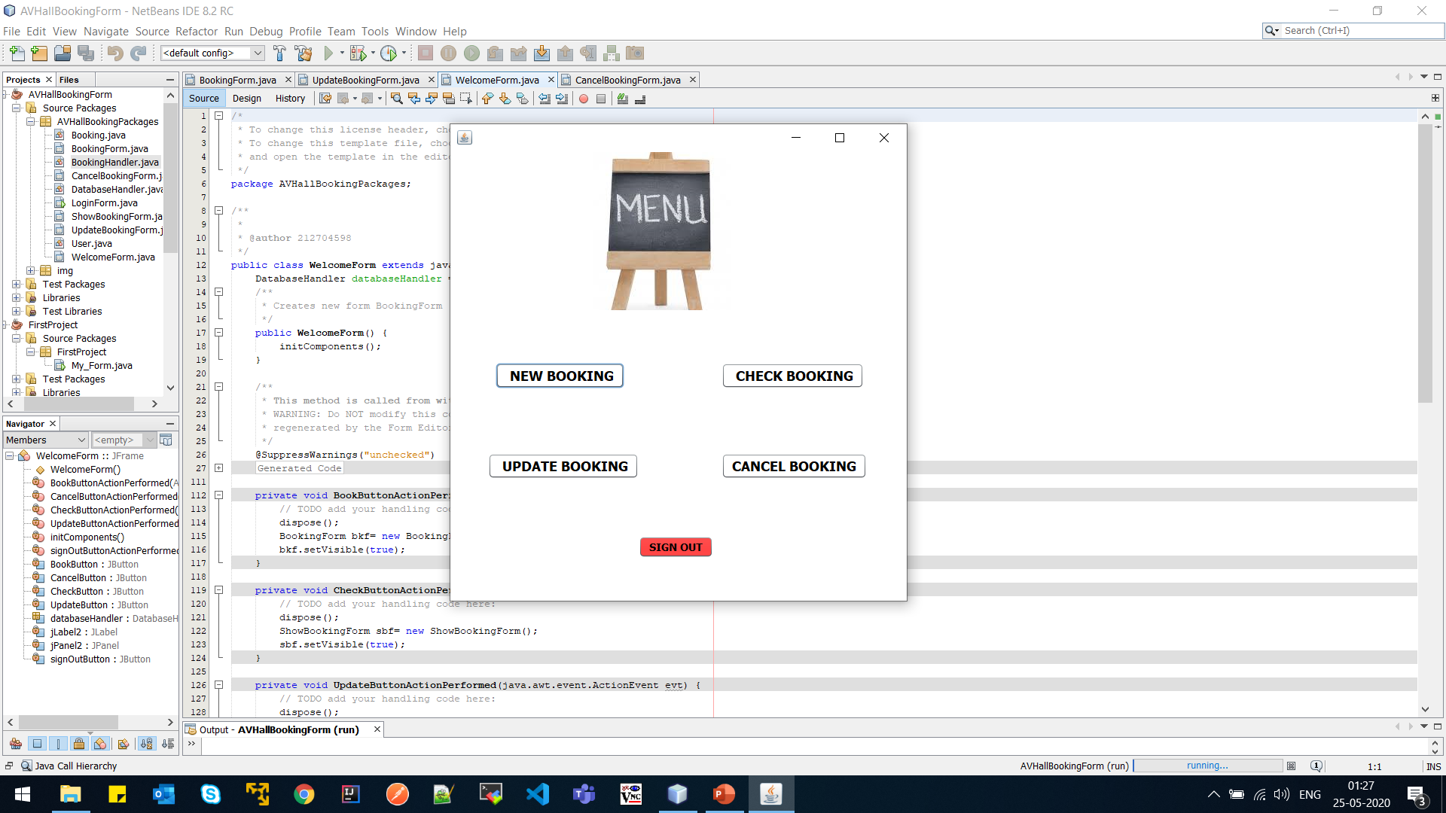
MENU SCREEN
HERE THE USER CAN SELECT FROM THE FOUR OPTIONS SHOWN TO HIM
THE BUTTONS WILL TAKE THE USER TO DIFFERENT PAGES TO CREATE,CHECK,UPDATE OR CANCEL HIS BOOKINGS
TO SIGN OUT USER CAN CLICK ON THE SIGN OUT BUTTON AT THE BOTTOM OF THE SCREEN
Notes:
THIS IS THE THIRD SLIDE

Slide 7
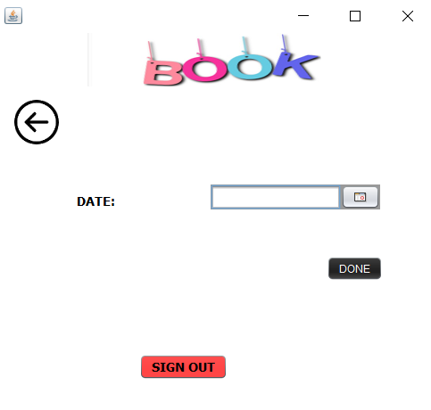
NEW BOOKING SCREEN
RESPECTIVE SCREEN WILL OPEN UP AS THE USER WILL CLICK ON THE NEW BOOKING OPTION
HERE USER IS ALLOWED TO CREATE A NEW BOOKING
USER WILL BE ASKED TO ENTER THE DATE OF BOOKING
ALSO USER CAN DIRECTLY GO BACK TO THE MENU PAGE CLICKING ON BACK ICON PRESENT ON THE SCREEN
USER CAN ALSO SIGN OUT DIRECTLY WITH THE HELP OF SIGN OUT BUTTON
Notes:
THIS IS THE FIFTH SLIDE

Slide 8
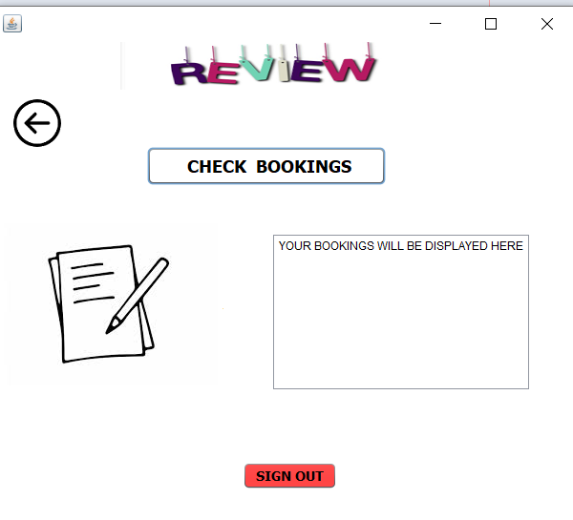
CHECK BOOKING SCREEN
RESPECTIVE SCREEN WILL OPEN UP AS THE USER WILL CLICK ON THE CHECK BOOKING OPTION
HERE USER IS ALLOWED TO CHECK THE BOOKING HE MADE PREVIOUSLY
ALSO USER CAN DIRECTLY GO BACK TO THE MENU PAGE CLICKING ON THE BACK ICON PRESENT ON THE SCREEN
USER CAN ALSO SIGN OUT DIRECTLY WITH THE HELP OF SIGN OUT BUTTON
Notes:
THIS IS THE SIXTH SLIDE

Slide 9
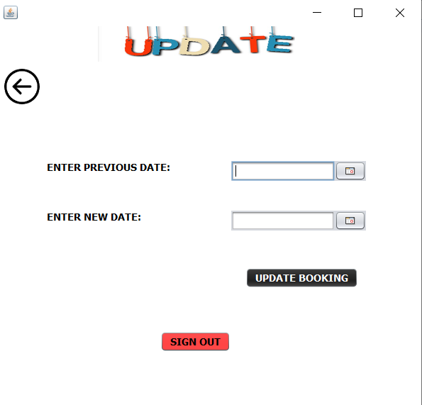
UPDATE BOOKING SCREEN
RESPECTIVE SCREEN WILL OPEN UP AS THE USER WILL CLICK ON THE UPDATE BOOKING OPTION
HERE USER IS ALLOWED TO UPDATE THE BOOKING HE MADE PREVIOUSLY
USER WILL BE ASKED TO ENTER PREVIOUS DATE HE WANT TO UPDATE AND NEW DATE TO UPDATE THE BOOKING
ALSO USER CAN DIRECTLY GO BACK TO THE MENU PAGE CLICKING ON THE BACK ICON PRESENT ON THE SCREEN
USER CAN ALSO SIGN OUT DIRECTLY WITH THE HELP OF SIGN OUT BUTTON
Notes:
THIS IS THE SEVENTH SLIDE

Slide 10
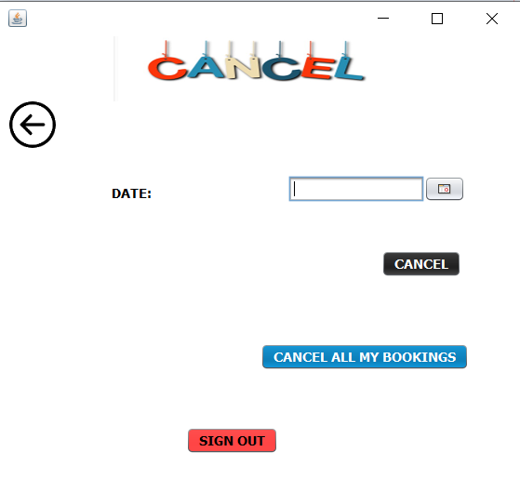
CANCEL BOOKING SCREEN
RESPECTIVE SCREEN WILL OPEN UP AS THE USER WILL CLICK ON THE CANCEL BOOKING OPTION
HERE USER IS ALLOWED TO CANCEL ALL OF HIS BOOKINGS OR A PARTICULAR BOOKING HE MADE PREVIOUSLY
USER WILL BE ASKED TO ENTER THE DATE FOR CANCELLING THE BOOKING
ALSO USER CAN DIRECTLY GO BACK TO THE MENU PAGE CLICKING ON THE BACK ICON PRESENT ON THE SCREEN
USER CAN ALSO SIGN OUT DIRECTLY WITH THE HELP OF SIGN OUT BUTTON
Notes:
THIS IS THE EIGTH SLIDE

Slide 11
THANK YOU
Notes:
LAST SLIDE

